Slide 1


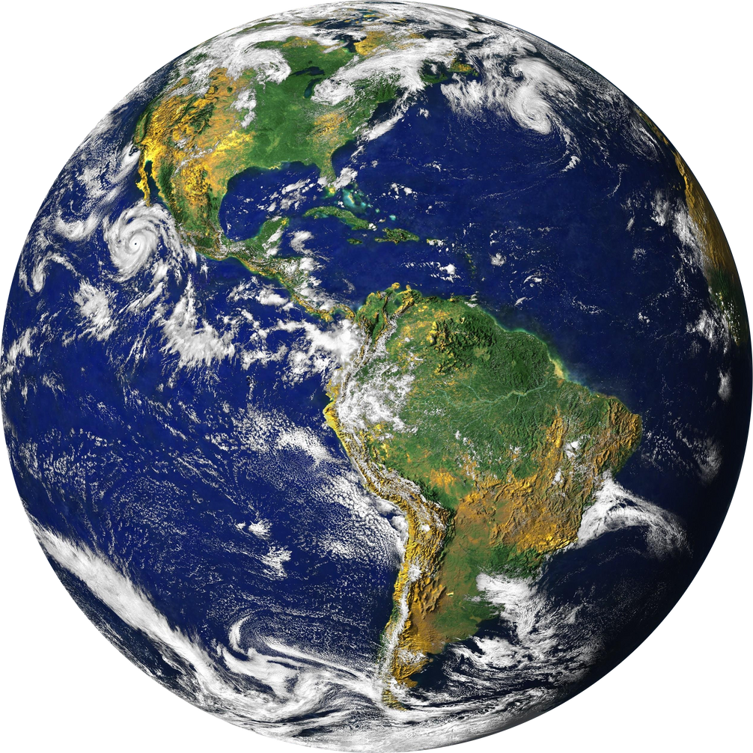
CARBON TRACK
AI-POWERED OPTIMIZATION FOR GREENER LIVING
Team: Flux
Rounak Mishra (leader)
Adarsh Jha
Shardul Pathak

Slide 2

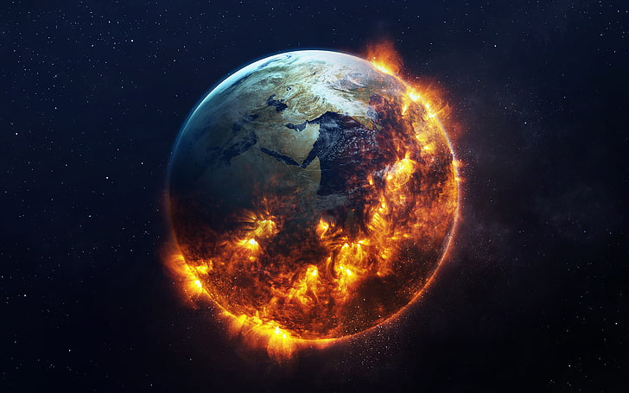
Carbon Crisis
Carbon emissions from daily activities like transportation, electricity usage, and consumption habits contribute significantly to climate change, leading to rising global temperatures, extreme weather events, and environmental degradation.

Slide 3
Accelerates Climate Change – Excess CO₂ emissions trap heat, causing global warming.
Increases Extreme Weather Events – More floods, heatwaves, and wildfires.
Leads to Rising Sea Levels – Coastal cities face flooding and displacement.
Causes Air Pollution & Health Issues – Higher rates of asthma, lung diseases, and heart problems.
AI cuts through the chaos—extracting data instantly, predicting impact with precision, and turning insights into action. Smart, fast, and game-changing.

Slide 4

Your Impact
Every action counts – Daily choices in transport, food, and shopping contribute to carbon emissions.
Lack of awareness – Most people don’t realize their personal impact on the environment.
Untracked = Uncontrolled – Without measuring emissions, reducing them is nearly impossible.
Collective action drives change – Small sustainable choices by millions can create a massive global impact.
Empowering individuals is key – A simple, accessible way to track and reduce footprints can make sustainability achievable for everyone.
People underestimate their personal impact on climate change. But the truth is, individual actions drive global change.

Slide 5
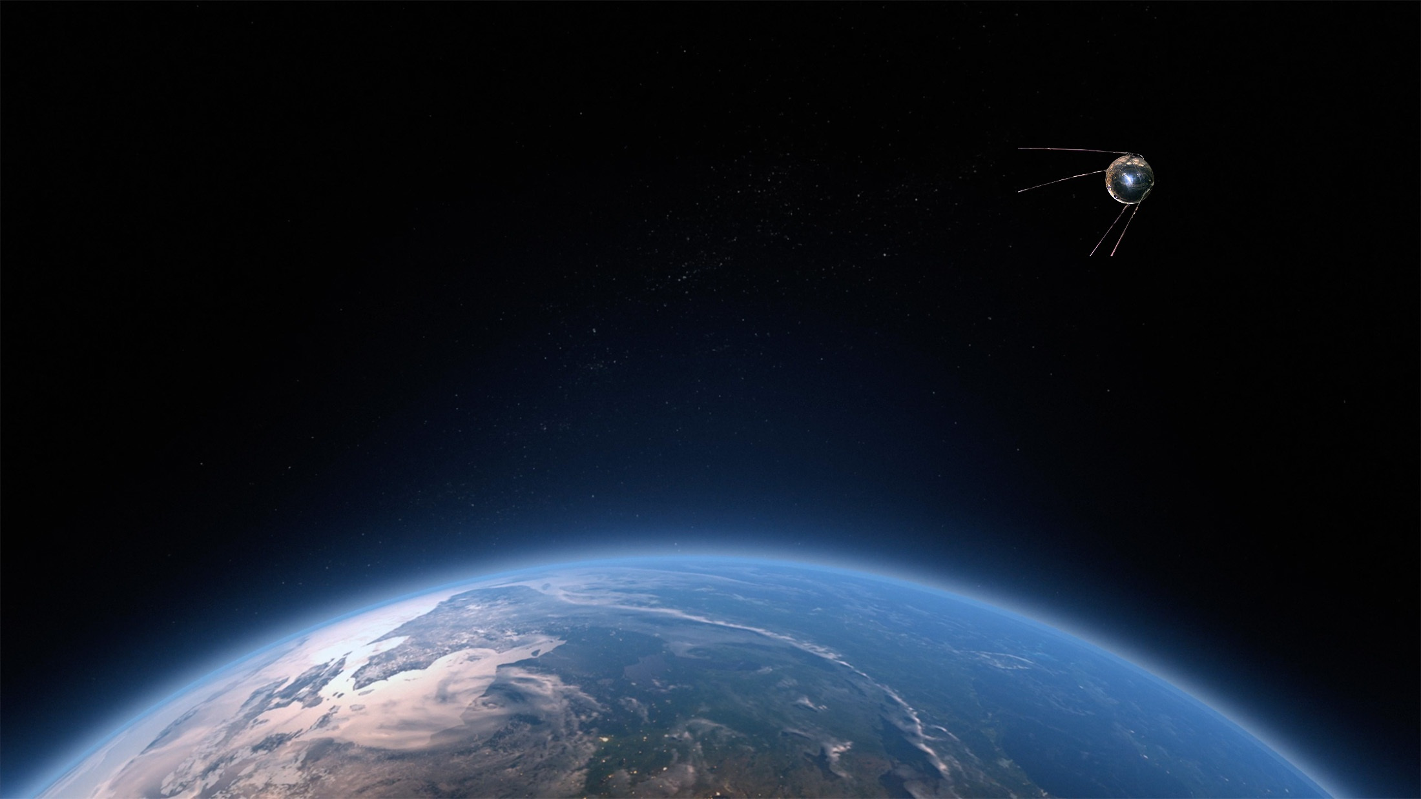
Tracking Woes
No easy way to track personal carbon footprints – Most people don’t know how much CO₂ their lifestyle generates.
Existing solutions are complex or inaccessible – Carbon tracking apps are either too technical or not user-friendly.
Manual tracking is tedious & inaccurate – People can’t estimate emissions without extensive research.
Lack of real-time insights – There’s no instant feedback on how daily choices impact the environment.
Without an easy, automated way to track and reduce emissions, sustainable living remains out of reach for most people.

Slide 6
CarbonTrack
Carbon Track solves this problem by providing an AI-powered, automated carbon footprint tracker that seamlessly integrates into daily life.

Slide 7
Smart Tracking
How It Works?
Smart Data Extraction – Using OCR (Optical Character Recognition), Carbon Track scans bills and receipts to identify purchases.
AI-Powered Carbon Estimation – Our model analyze product categories and estimate their carbon footprint based on predefined emission factors.
Real-Time Insights – Users receive instant feedback on their footprint, with clear visualizations to track patterns over time.
Recommendations based performance – AI suggests tailored, actionable steps to reduce emissions, such as alternative products or behavioral changes.
User-Friendly Dashboard – An interactive dashboard helps users monitor trends, set sustainability goals, and stay motivated.

Slide 8
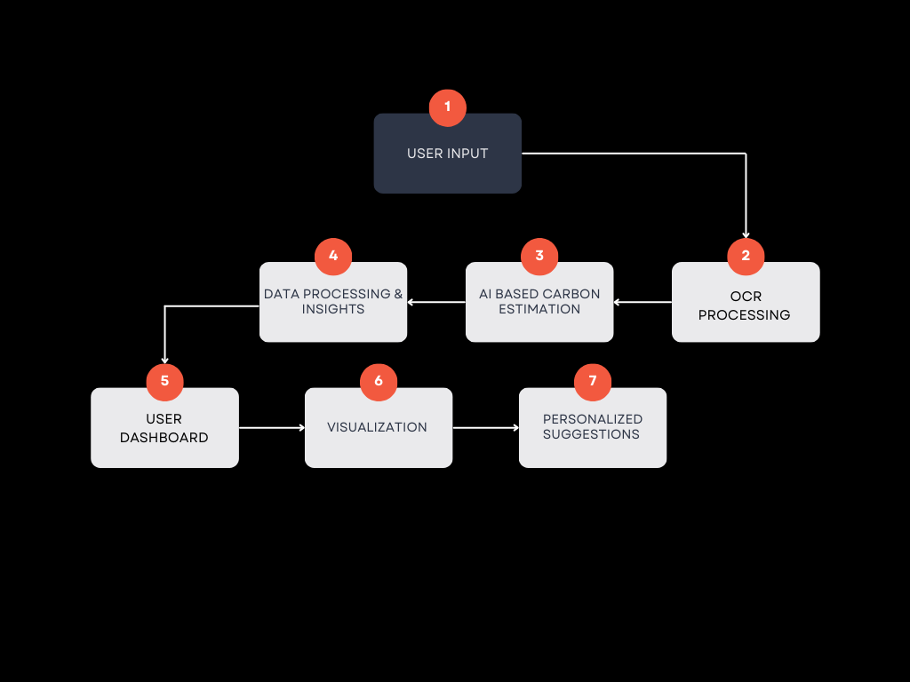
Eco Pathway

Slide 9

Eco Revolution
OCR-Powered Bill Scanning – Simply upload a bill, and our AI extracts product details automatically—no manual input needed.
AI-Based Carbon Estimation – Our intelligent system analyzes each product and calculates its carbon footprint based on verified emission data.
Personalized Insights & Recommendations – Get smart suggestions on how to lower your emissions, tailored to your lifestyle and habits.
Visual Analytics Dashboard – Track your footprint over time with intuitive graphs, comparisons, and progress reports.
Fast, Simple & User-Friendly – No complex calculations or overwhelming data—just instant, easy-to-understand insights.
01
02
03
04
05
Carbon Track is designed to make carbon footprint tracking effortless, accurate, and actionable.

Slide 10
AI : The Game Changer
CarbonTrack isn't just another carbon tracker
It uses AI to make sustainability effortless and accurate.
AI + Carbon Track makes sustainability smarter, faster, and more effective—turning awareness into action!

Slide 11
Key Features
🔹 Fully Automated – No manual data entry; just scan a bill, and AI does the rest.
🔹 High Accuracy – AI-powered carbon estimation ensures precise calculations based on real-world data.
🔹 Smart Insights – AI breaks down emissions by category (food, travel, shopping) and helps users understand their impact.
🔹 Personalized Recommendations – Adaptive AI suggests tailored actions based on individual habits and spending patterns.
🔹 Continuous Improvement – The more users track, the smarter the AI becomes, refining estimations for better accuracy.

Slide 12

Tech Core

Slide 13
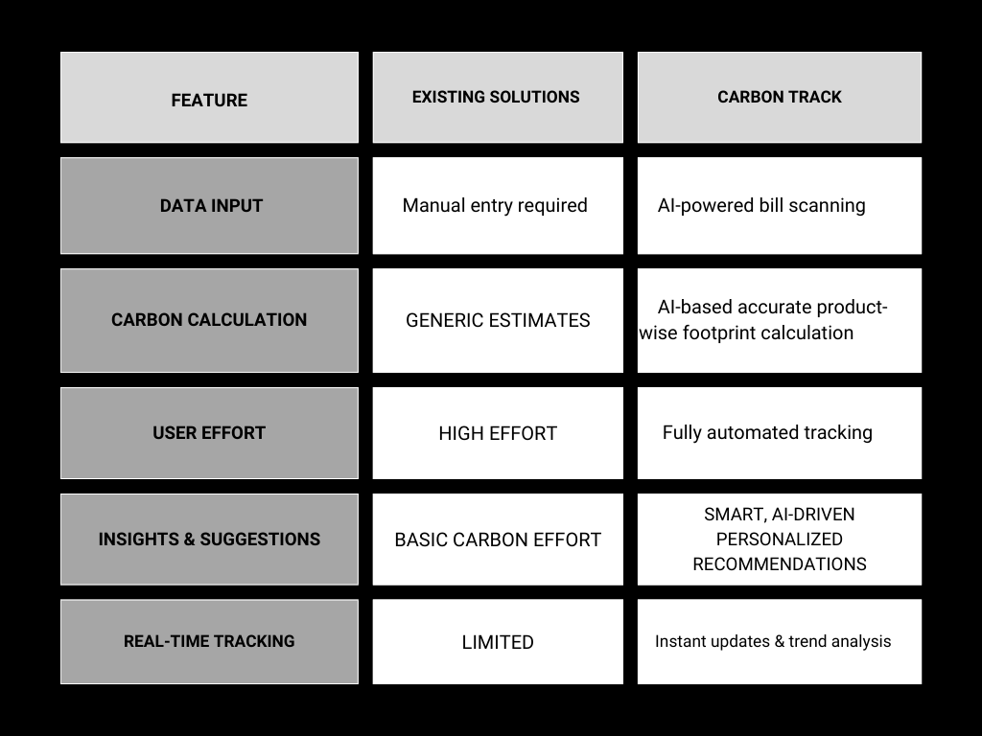
How CarbonTrack is different from existing solutions ?

Slide 14
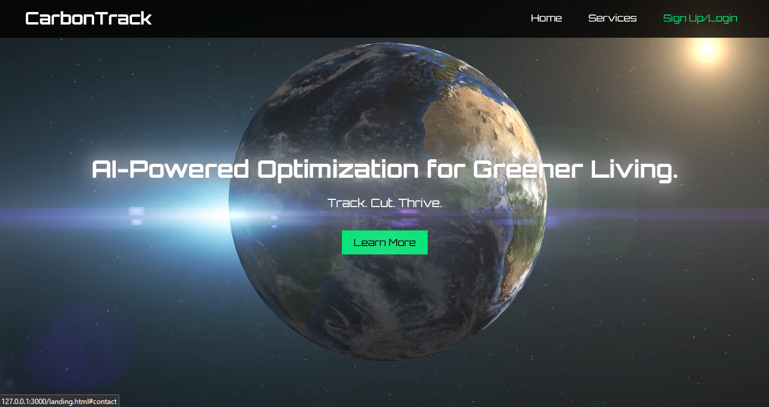
Carbon Footprint in Action!

Slide 15
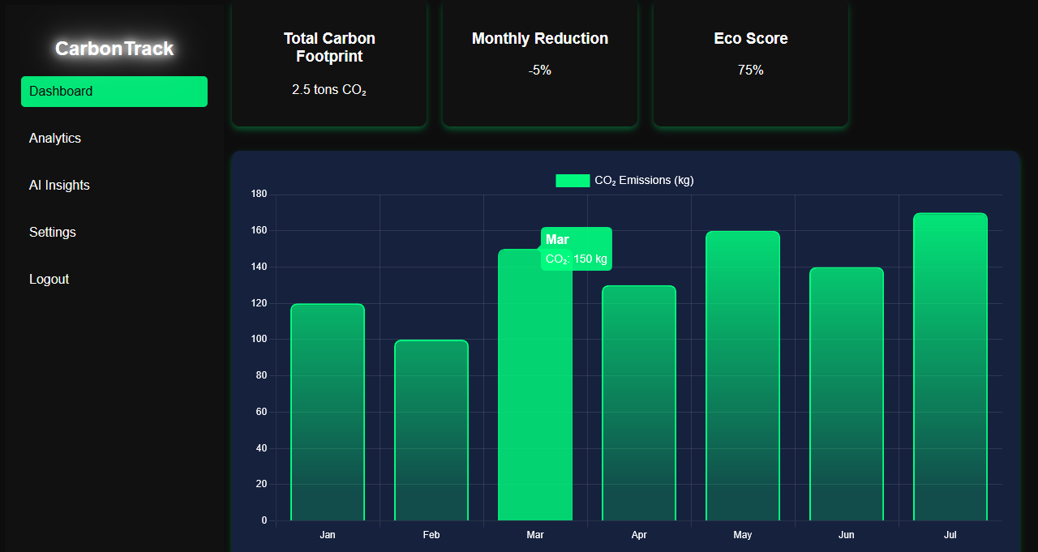

A smart, intuitive dashboard that visualizes your carbon footprint, tracks trends, and provides AI-driven sustainability insights.
AI-powered insights analyze your habits, provide real-time carbon reduction tips, and suggest eco-friendly alternatives effortlessly.

Slide 16

Future Horizons
🔹 Expanding Data Sources
Integrate with bank transactions & e-receipts for automatic tracking without needing bill uploads.
Fetch carbon footprint data from product barcodes to improve accuracy.
🔹 Business & Enterprise Integration
Offer a corporate version to help companies track & offset employee emissions.
Collaborate with governments & NGOs for large-scale adoption.
🔹 AI Model Enhancements
Train AI on more diverse datasets to refine carbon footprint estimations.

Slide 17





CONTACT US
Contact
9340194244
7559287930
9579933098
Adarsh Jha
Rounak Mishra
Shardul Pathak
Adarsh2709
Rounak Mishra
Shardul Pathak
jhaadarsh709@gmail.com
rounakkm2006@outlook.com
shardulpathak796@gmail.com

Slide 18

By harnessing AI technology, we can accurately measure, analyze, and
reduce our carbon footprints — one decision at a time.
Every small step counts
Together, we create change
Be the Change
Awareness Drives Action
Data-Driven Decisions
Impact Begins...

